Slide 1



Project Title Accounts Payables operations in Oracle ERP

Slide 2
Track : Oracle Digital Accounting Specialist Group Code : NXT26_ONL2_ERP4_S3

Slide 3
Group Members: 1- Lamia Sinwan Salah El-Dein 2- Farida Mohamed Eid 3- Jumana Mohamed Ashraf 4-Dina 5-Mohamed Maged 6-Mohamed Mahmoud

Slide 4
Oracle EB Financials Modules:
1-General Ledger (GL)
2- Account Payables (AP)
3-Fixed Assets
4-Cash Management(CM)

Slide 5
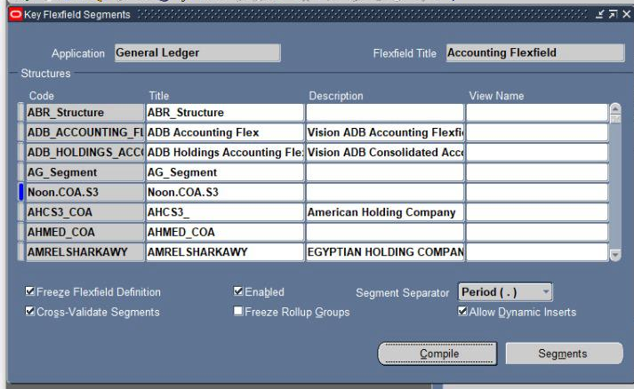
1-Oracle General Ledger. I.Defining Ledger Sets.
1. Creating Chart of Accounts.
Setup -> Financials -> Flexfields -> Key -> Segments
Query Application as General Ledger and Flexfield Title as Accounting Flexfield
Place cursor on structures code click on new
Enter the new structure name Noon.COA.S3

Slide 6
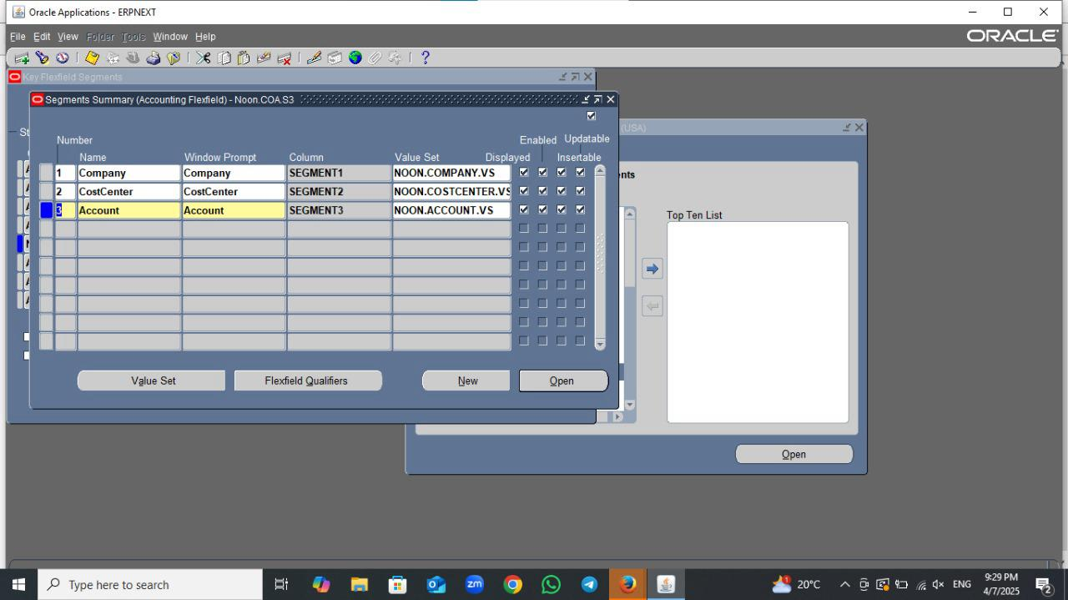
Next Click on Segment button ,
then Use the Segments window to define segments for your flexfield.
Use flexfield qualifiers to identify certain segments used for specific purposes.
1-Company -->Balancing Segment.
2-Cost Center--> Cost Center Segment
3-Account--> Natural Account segment

Slide 7
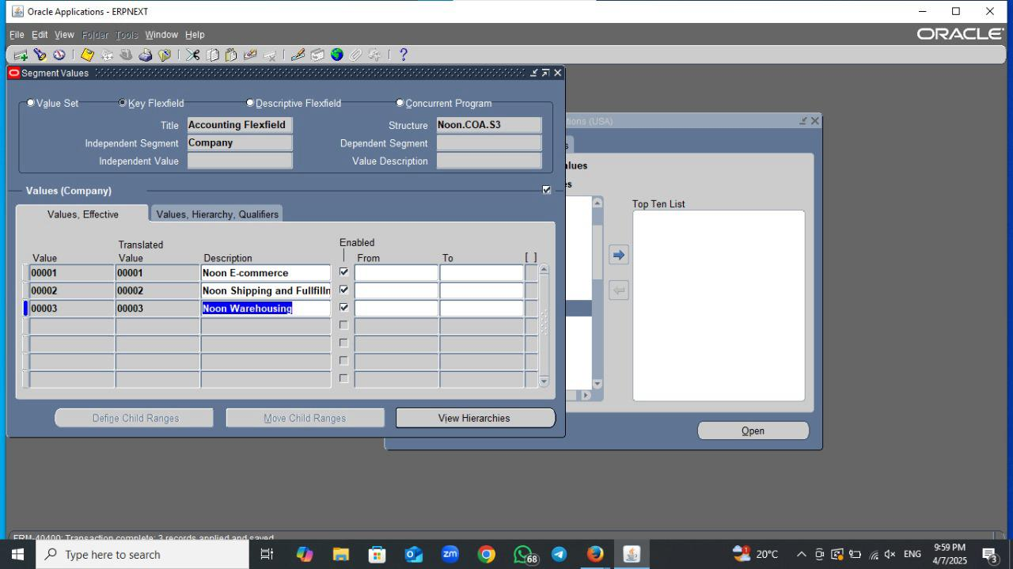
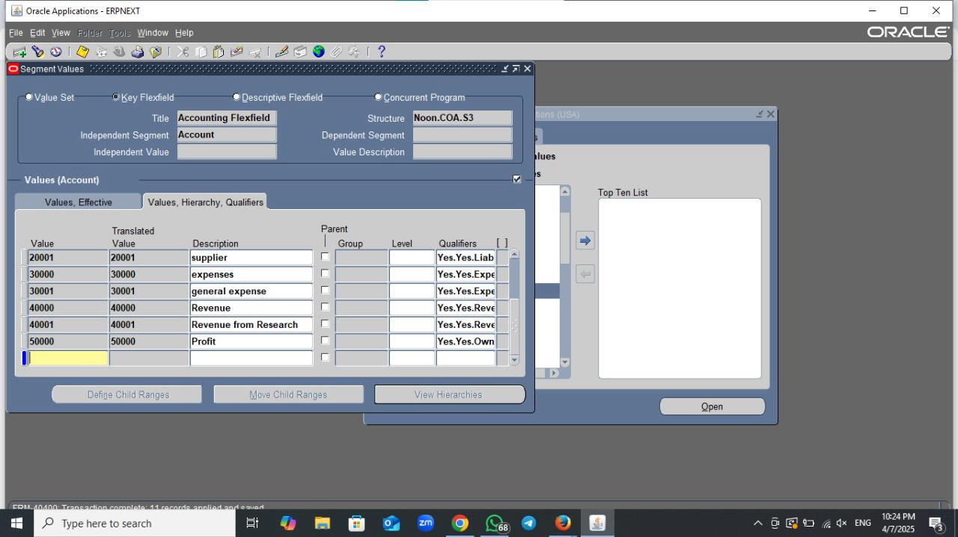
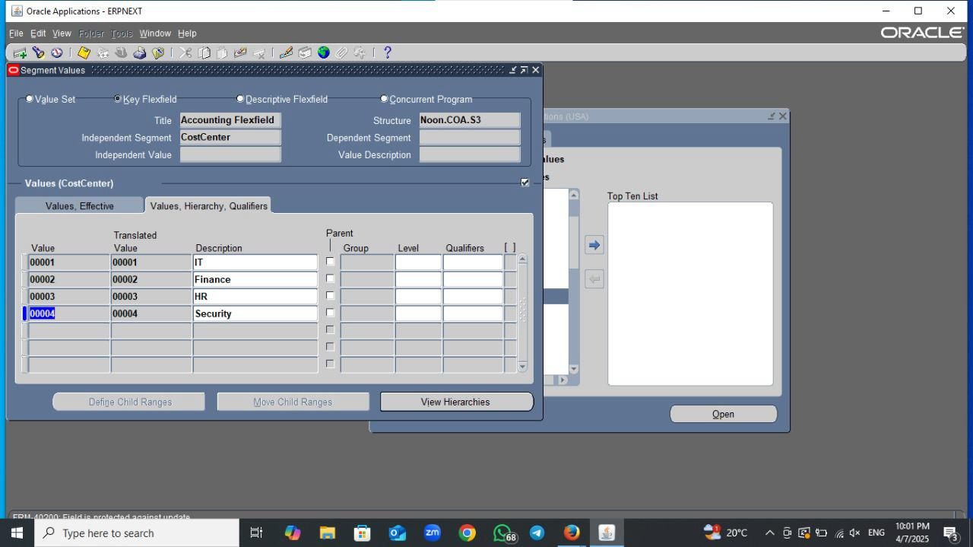
Setup-> Financials-> Flexfields-> key-> Value
Add Values for each segment.

Slide 8
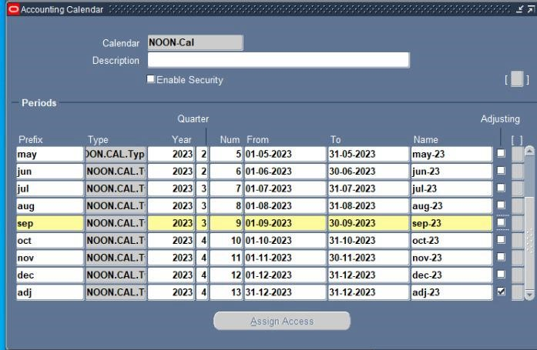
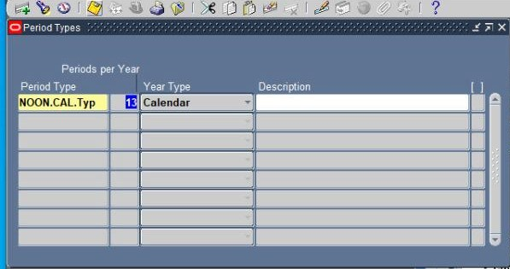
2. Defining Calendars.
A-Defining Period Types.
-Setup-> Financials-> Calendars-> Type
B-Creating New Calendar.
Setup-> Financials-> Calendars-> Accounting

Slide 9
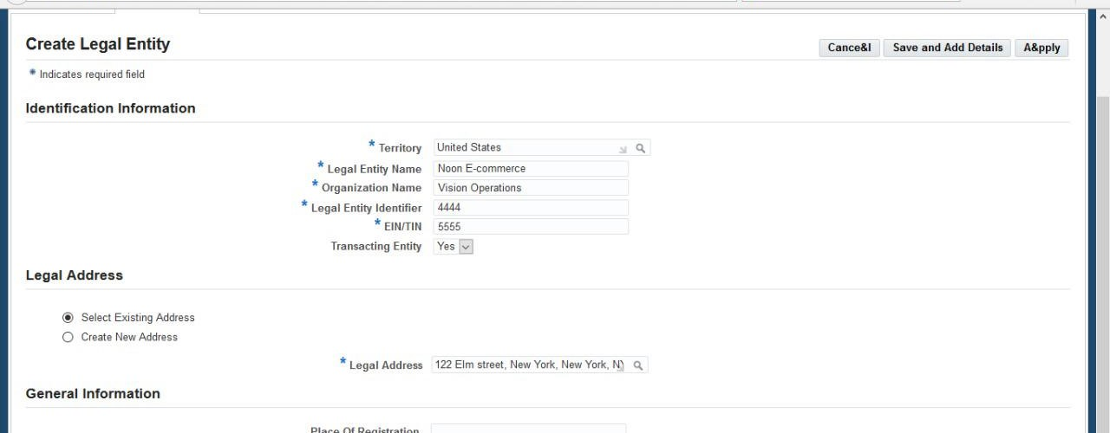
3-Accounting Setup.
A-Setup-> Financials-> Accounting Setup Manager-> Accounting Setups.
B-Click on Create Accounting Setup button.
C-Enter the Territory as United States then enter the Legal Entity information.
--->Apply

Slide 10
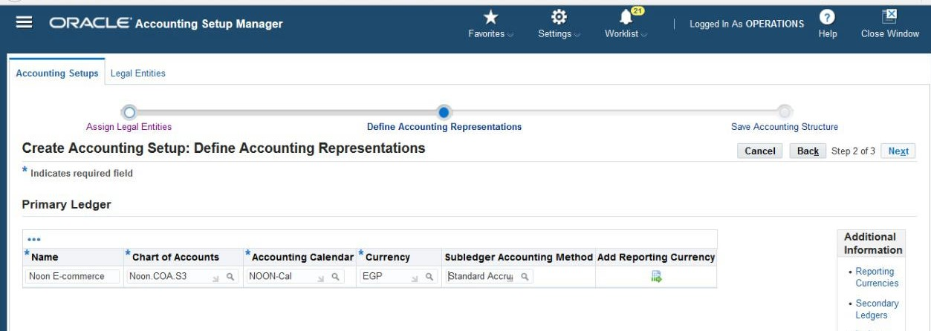
Click on Create Accounting Setup button.
Click on Add Another Row button and enter the newly created legal entity name and click on Next button.
Enter the Primary Ledger name as Noon E-commerce , Chart of Accounts as Noon.COA.S3 , Accounting Calendar as NOON-Cal , Currency EGP and Subledger Accounting as Standard Accrual Click on Next button then Finish.

Slide 11
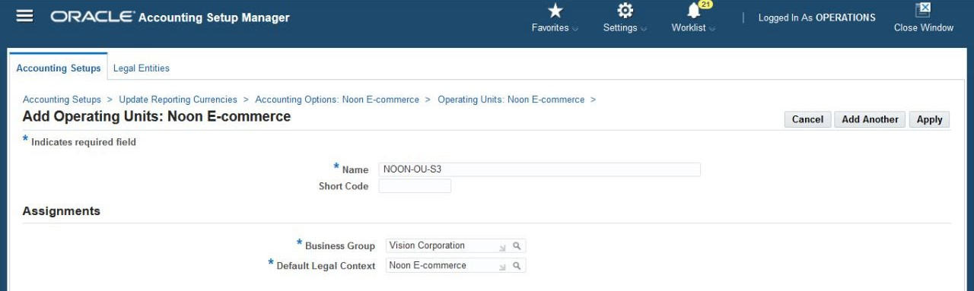
4-Add Operating Units
Enter the required fields like name of Operating unit as NOON-OU-S3, Business Group as Vision Corporation , Default Legal Context as Noon E-commerce and Click on Apply.

Slide 12
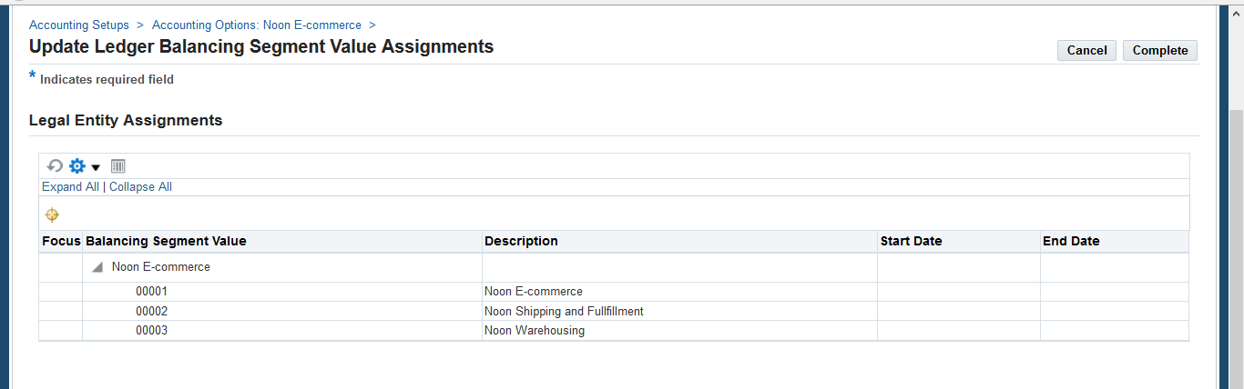
Click on Define Accounting Options button.
Click on Balancing Segment Value Assignments and click on Update icon.
Add Balancing Segment Values (00001 Noon E-commerce,00002 Noon shipping and fullfillment, 00003 Noon Warehousing)

Slide 13
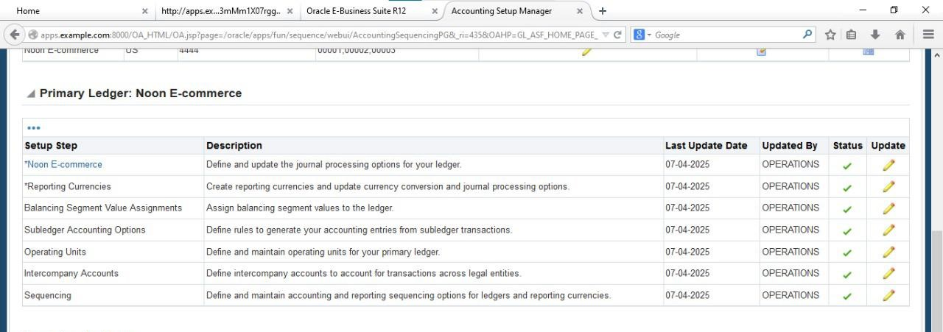
Then Update The Other Accounting Setups as Noon E-commerce, Reporting Currencies, Subledger Accounting Options, Operating Units ,Intercompany Accounts and Sequencing and add the required information then change the status to complete and Apply.
Check all the Setup step
status are completed
then Click on Complete.

Slide 14
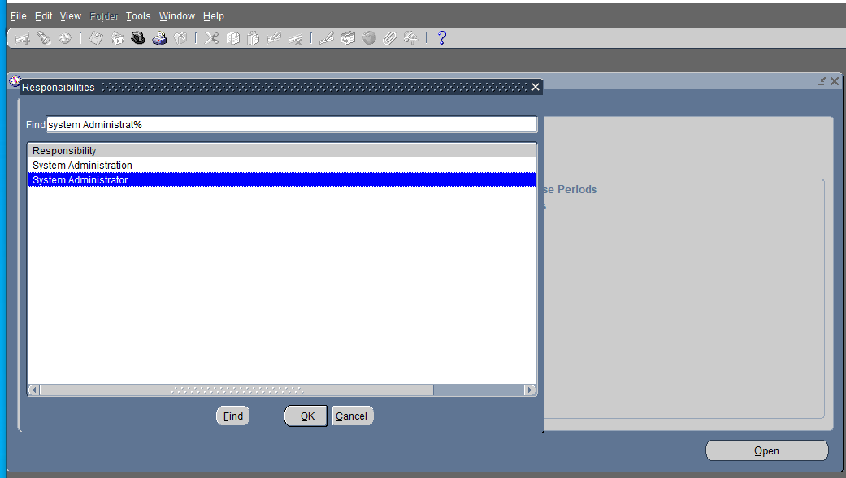
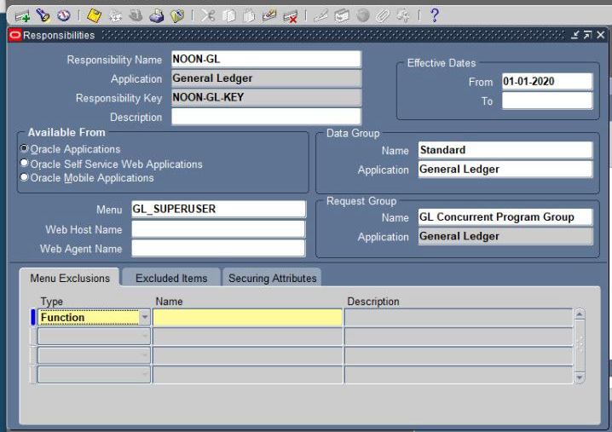
II.Defining User
1)Switch Responsibility to System Administrator.
2) Security >Responsibility>Define.
Create Responsibility.

Slide 15
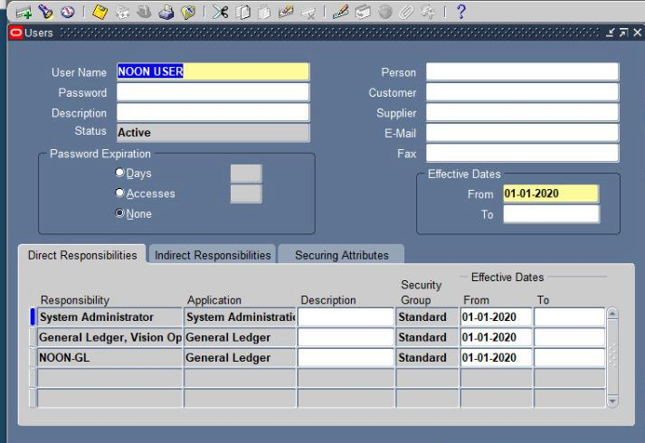
3) Security> User> Define.
Add user Name NOON USER
Create New Password .
Add the Responsibilities.
Then Save.

Slide 16
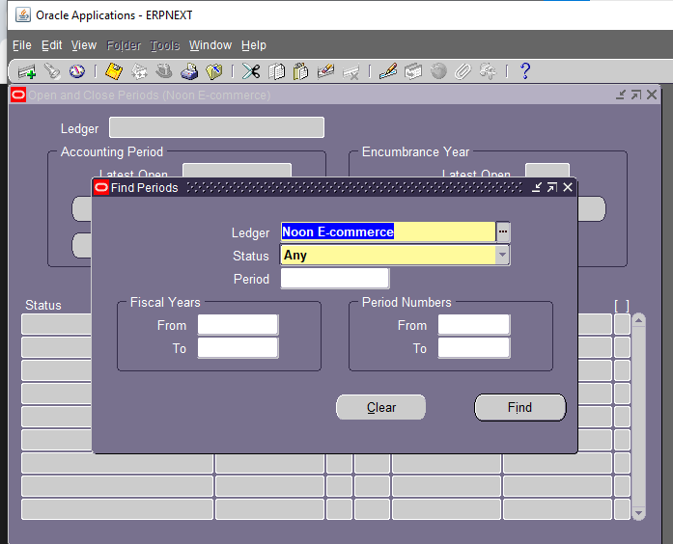
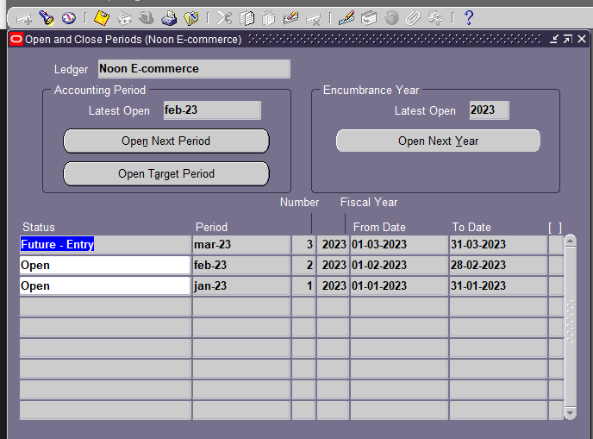
Login to NOON USER.
Setup -> Open/Close
Change status to any then click find and open.

Slide 17
Oracle EBS Financials Modules:
1-General Ledger (GL)
3-Fixed Assets
4-Cash Management(CM)
2-Account Payables (AP)

Slide 18
Objective
To enable the user to manage the lifecycle of Account payables , including create supplier , do invoice , payments , do reports and perform period closing tasks in the Account Payables module.

Slide 19
Contents
Account Payables Life cycle in oracle :-
Inventory
AP Responsibility
AP Setup
Create Supplier
Make invoice
Invoice Payments
Period close activities
Month end close periods

Slide 20
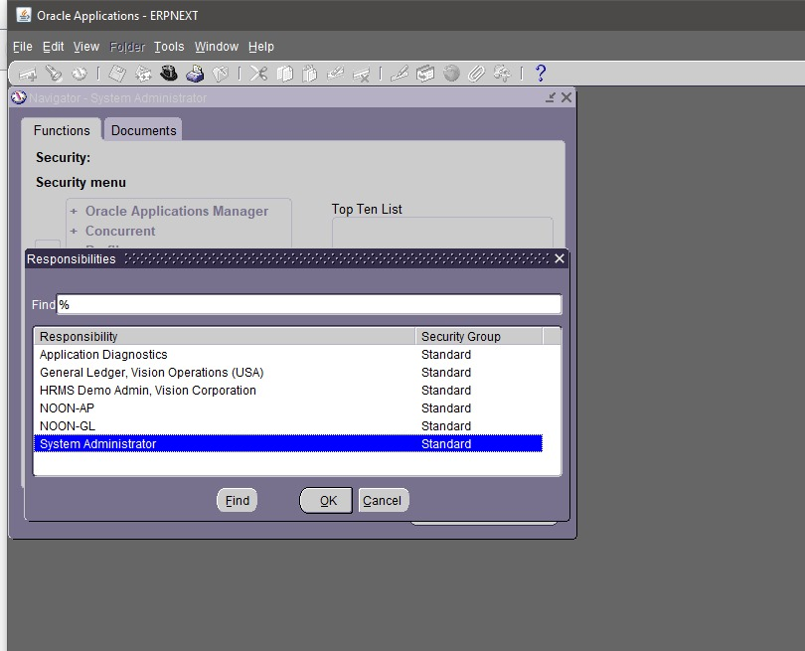
1- Accounts payables Responsibility
Switch to System Adminstrator Responsipiliy
1. N:- File >Switch Responsibility > System Adminstrator

Slide 21
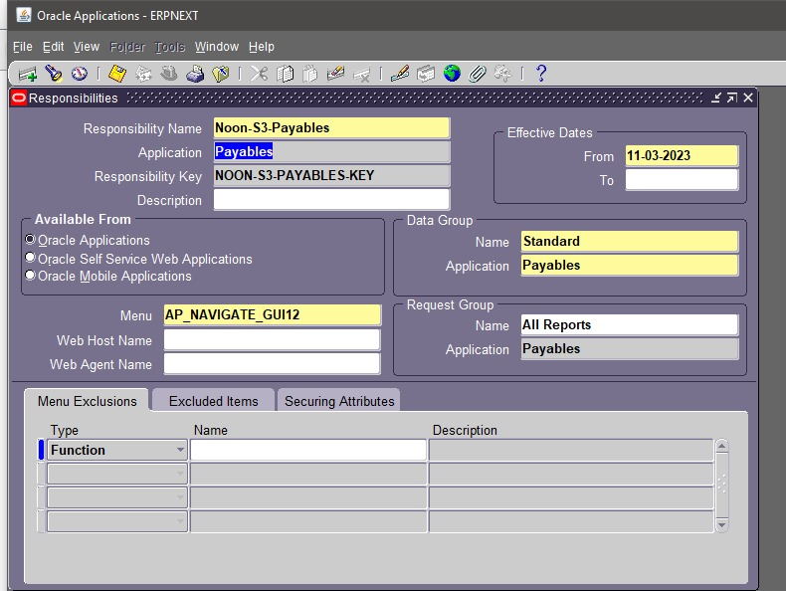
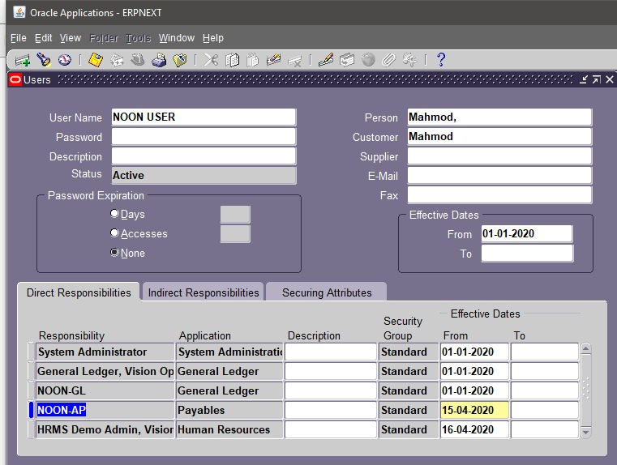

2. N : Security > Responsibility >Define 3. Enter Responsipility Name ,Data Group , Dates , Menue . 4. Attach the Responsipility to NOON USER N: Security >User>Define 5. Save your work and close

Slide 22
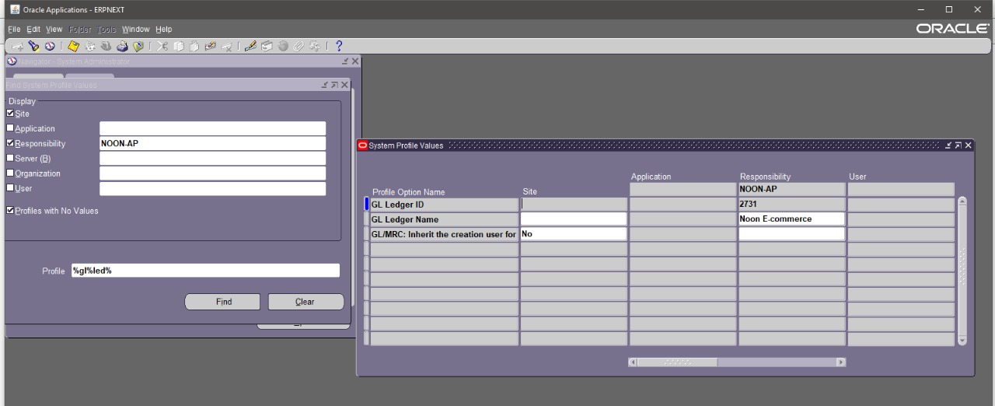
7. Define Values N:- Profile >System 8. Enter profile as %gl%led% 9. Click on find 10. Enter Application as payables 11. Responsipility as NOON –AP 12. Click find

Slide 23
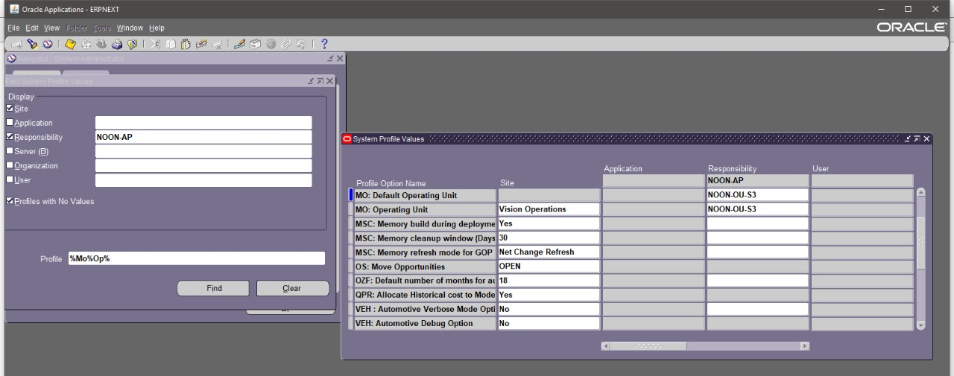
13. Enter Profile as %MO%OP% 14.cliclk on find 15. Enter the MO Operating Unit at Reponsipility Level as NOON-OU-S3

Slide 24
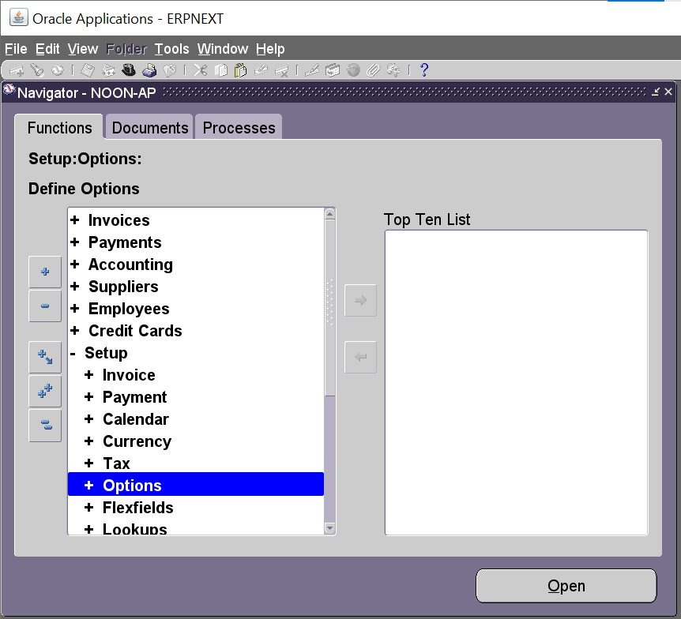
2-Oracle Payables Set up
1.Options
Financial Options
Payables Options

Slide 25
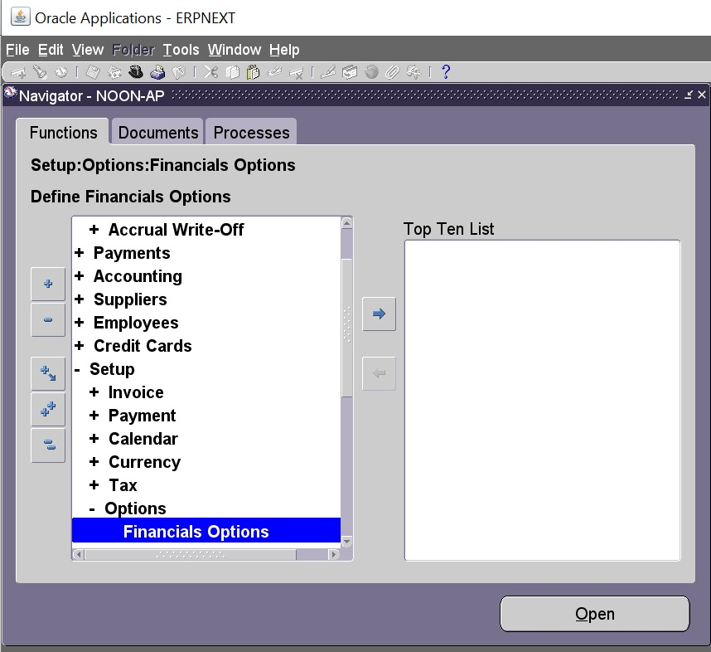
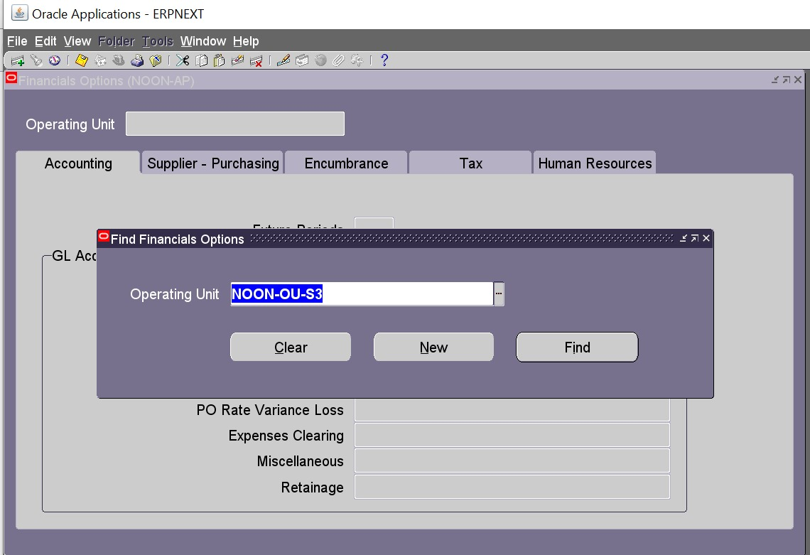
a. Financal Options - Setup > Options > Financial Options - Financial options include :- Accounting -Supplier, Purchasing - Encumbrance-Tax -Human Resources
Click Find
to link and define our operating unit

Slide 26
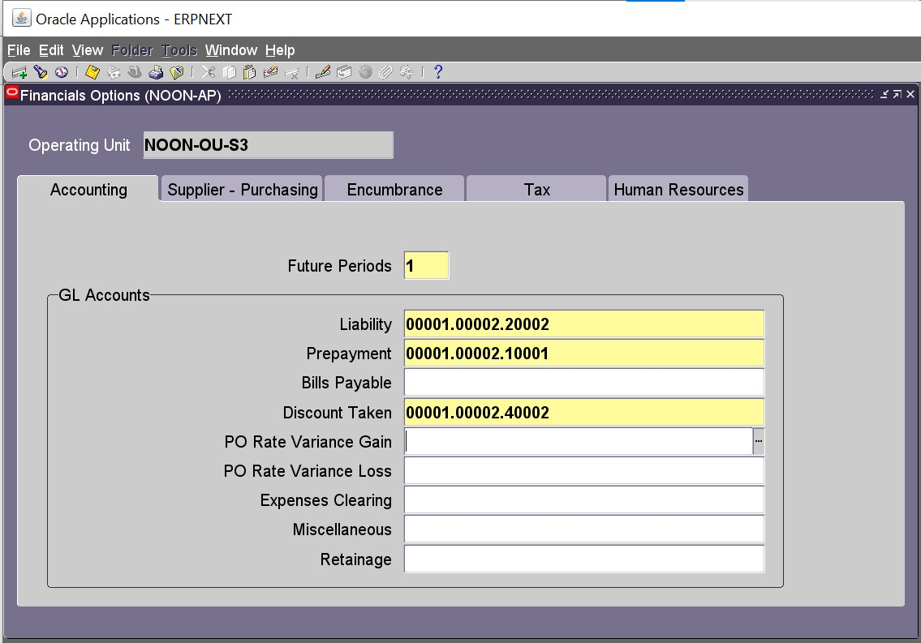
1-Accounting Financial Options . Future period is one . . Assign GL Accounts :- Liability , prepayment ,Discount Taken accounts .

Slide 27
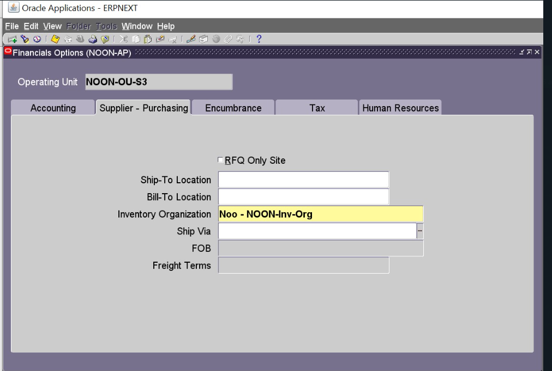
2-You need to choose an inventory organization if you use Purchasing.You need to choose an inventory organization if you use Purchasing.

Slide 28
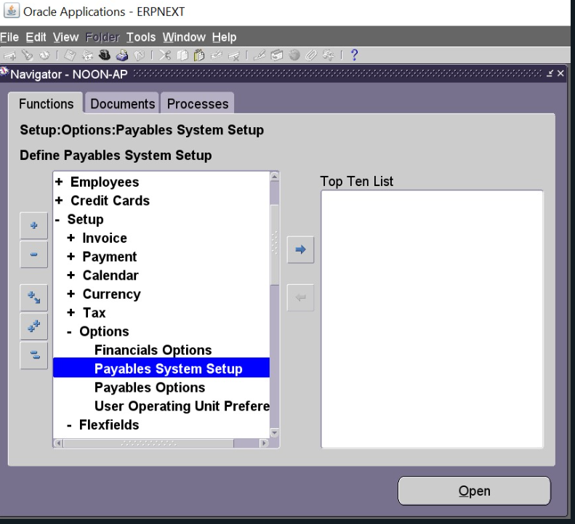
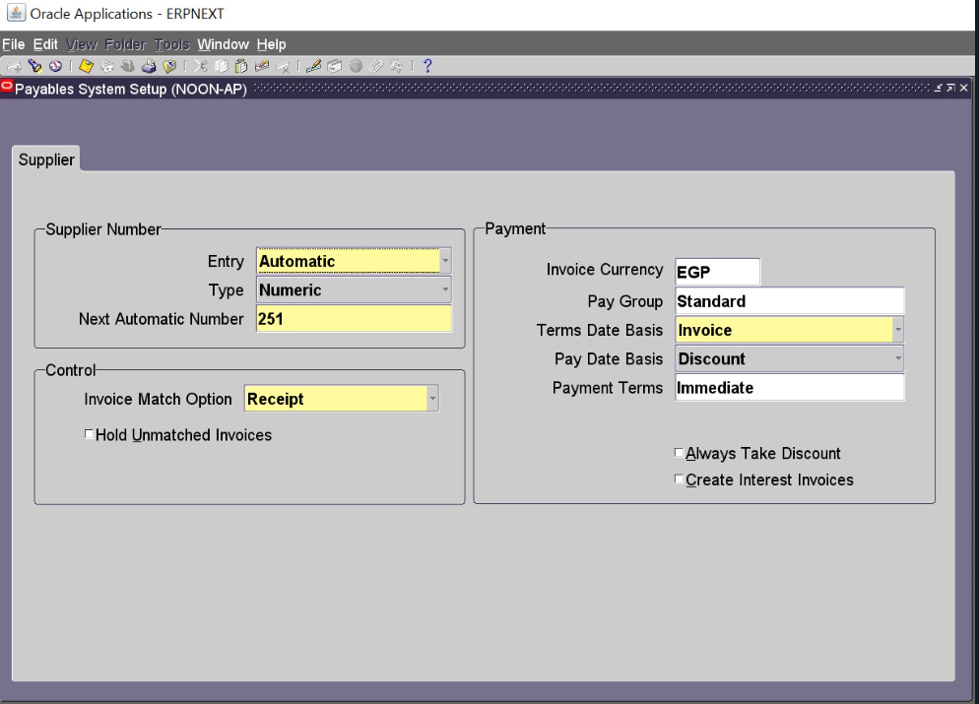

Slide 29
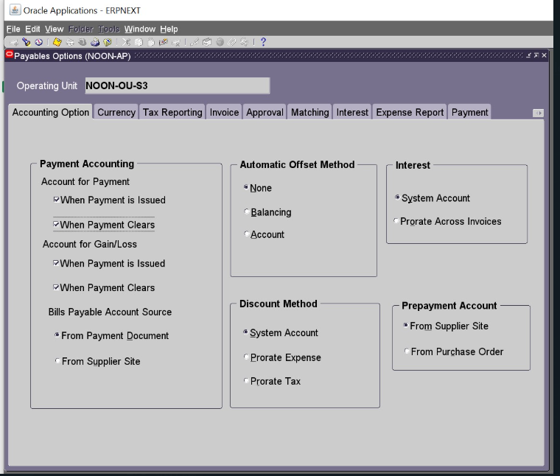
B- Payables options​ 1-Setup > Options > Payables Options​

Slide 30
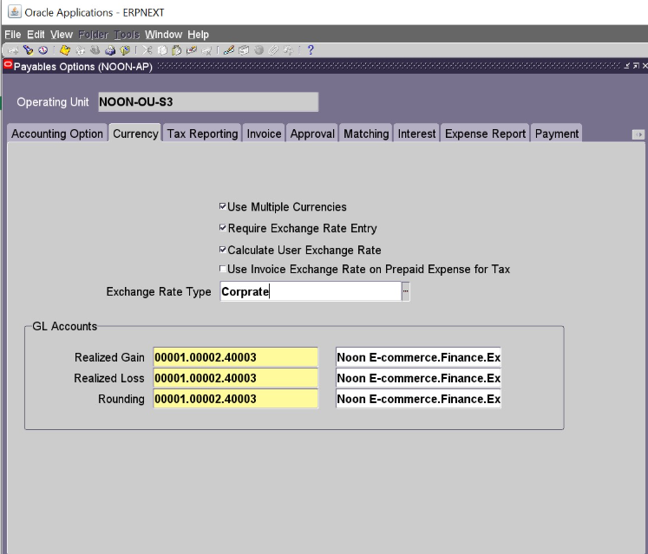
-Currency payable options:
Use Multiple currencies.
Require exchange rate entry.
Calculate user exchange rate.
-Exchange Rate Type: Payables uses this as the default exchange rate type when you enter invoices or create payments..
-Choose realized gain and loss account for payments from each of your bank accounts.

Slide 31
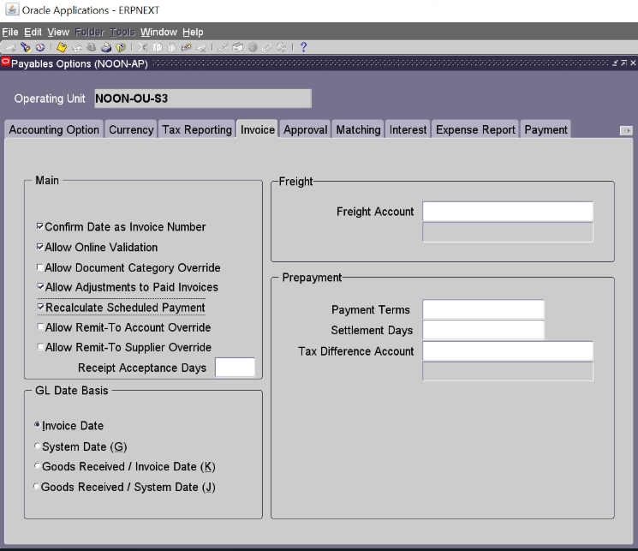
Confirm date as invoice number .
Allow online validation.
Allow adjustments to paid invoices.
Recalculate scheduled payment.

Slide 32
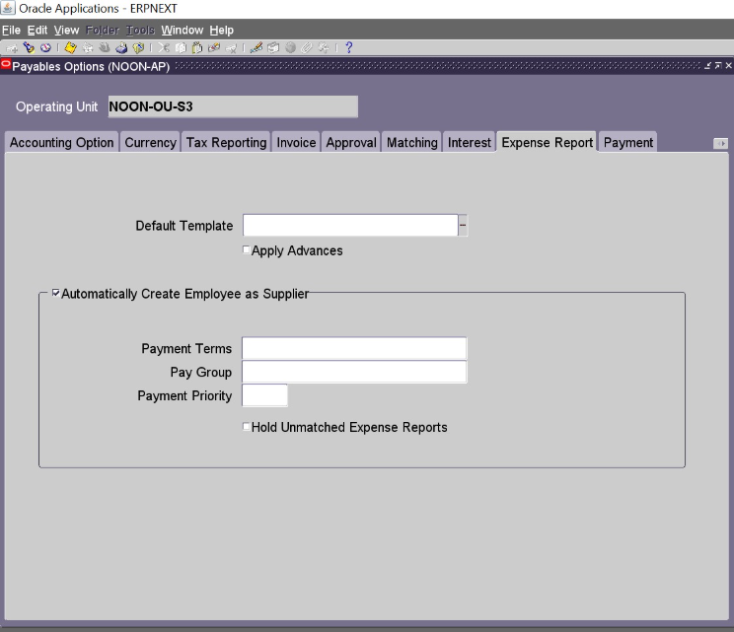
Payables automatically creates a supplier for any expense report where an employee does not already exist as a supplier.

Slide 33
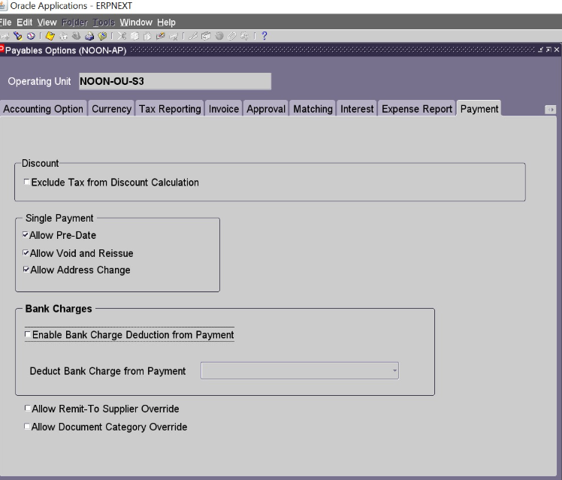
Allow pre-date.
Allow void and reissue.
Allow address change.

Slide 34
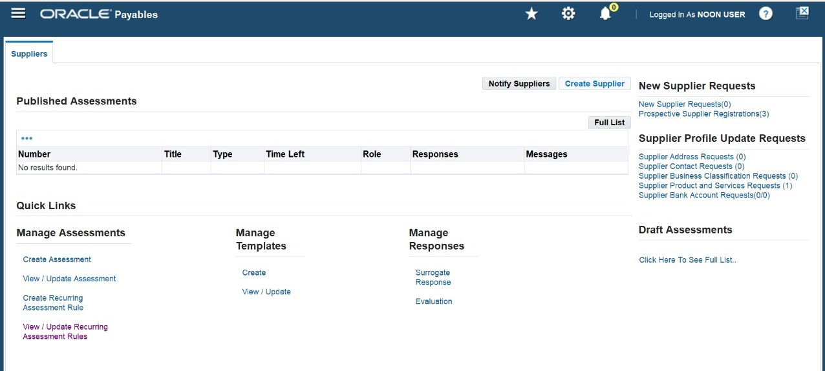
3-Create Supplier
Supplier> Entry>Create Supplier

Slide 35
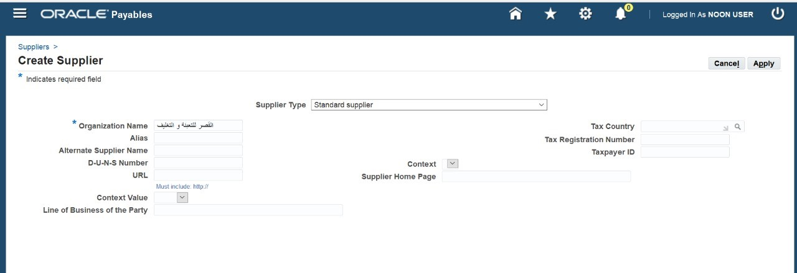
2- Insert Organization Name القصر للتعبئة و التغليفwhich is the packaging supplier for Noon Company.

Slide 36
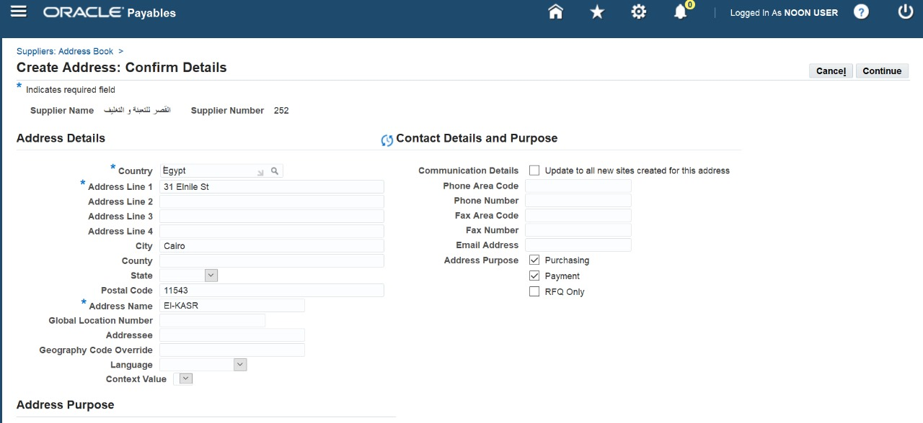
3- Address Book> Create
Add Country: Egypt.
Address Line1: 31 Elnile st.
Address Name: El-Kasr
Purchasing.
Payment.

Slide 37
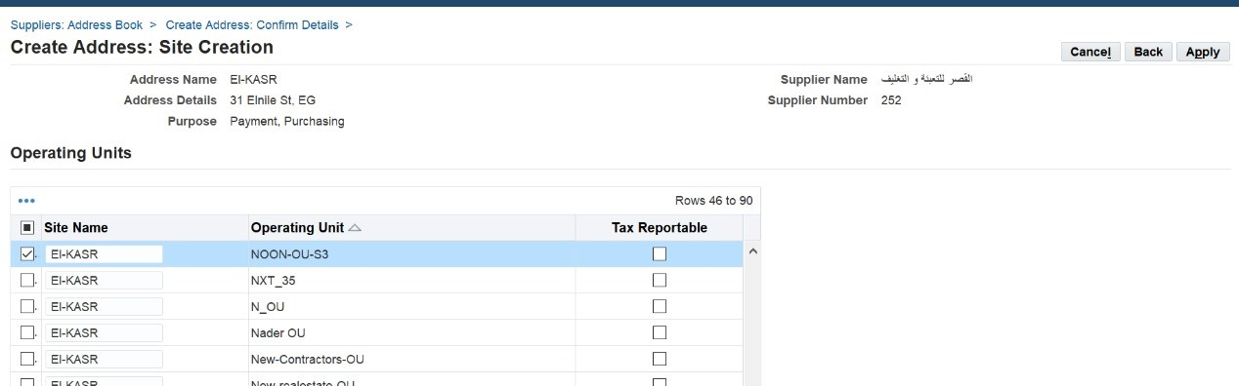
4-Linking the supplier القصر للتعبئة و التغليف
The appropriate operating unit
NOON-OU-S3.
> Apply

Slide 38
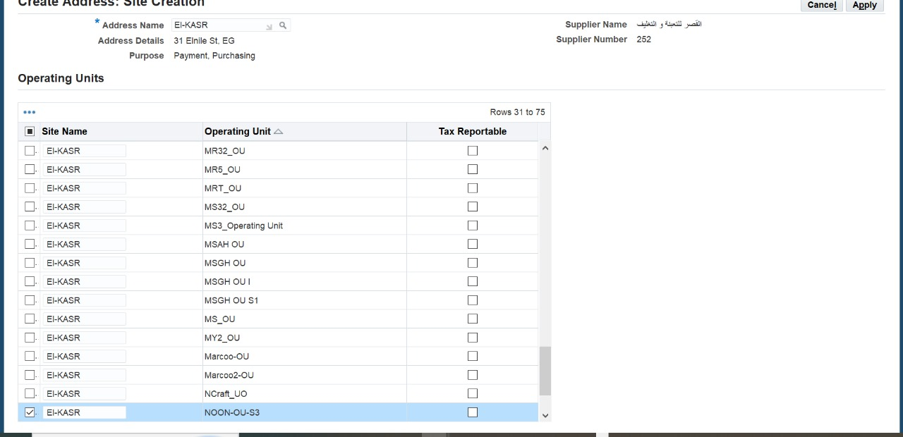
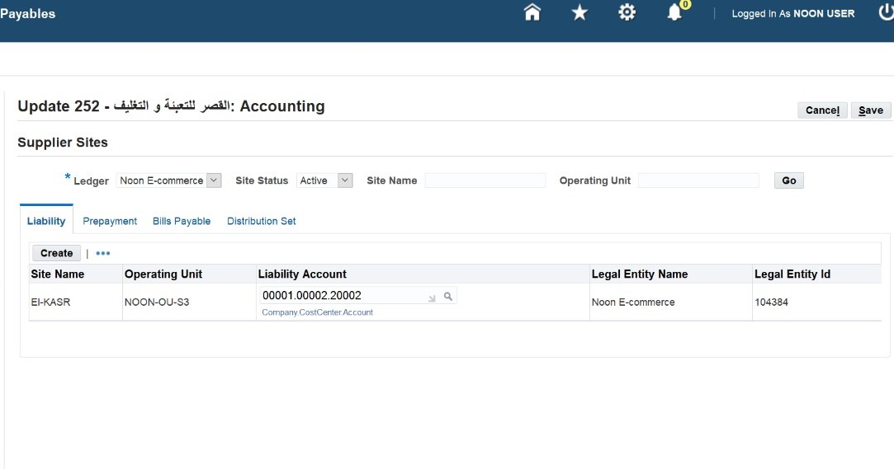
6-Liability account is successfully assigned to supplier site under the correct operating unit and legal entity.
5-Linking supplier site to Operationg unit.

Slide 39
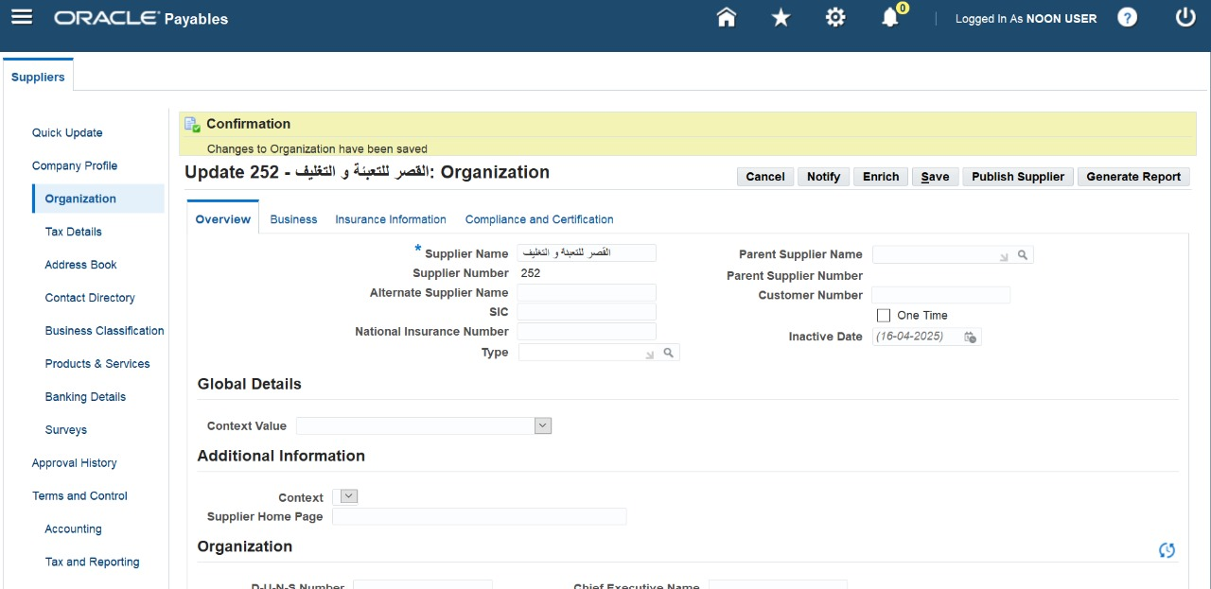
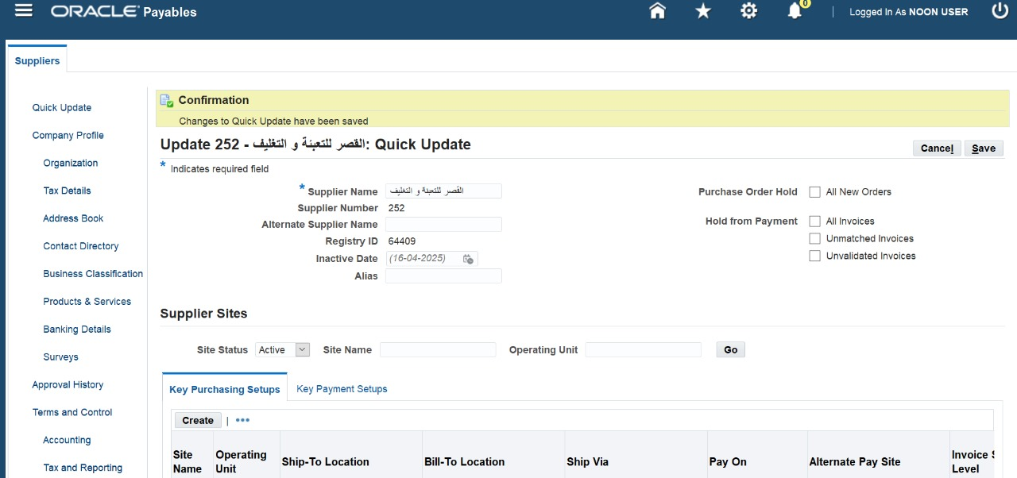
7-Added supplier’s main information including name and supplier number, then saved the changes.
8-Next, I added the registry ID, set the site status to active, then saved the changes.

Slide 40


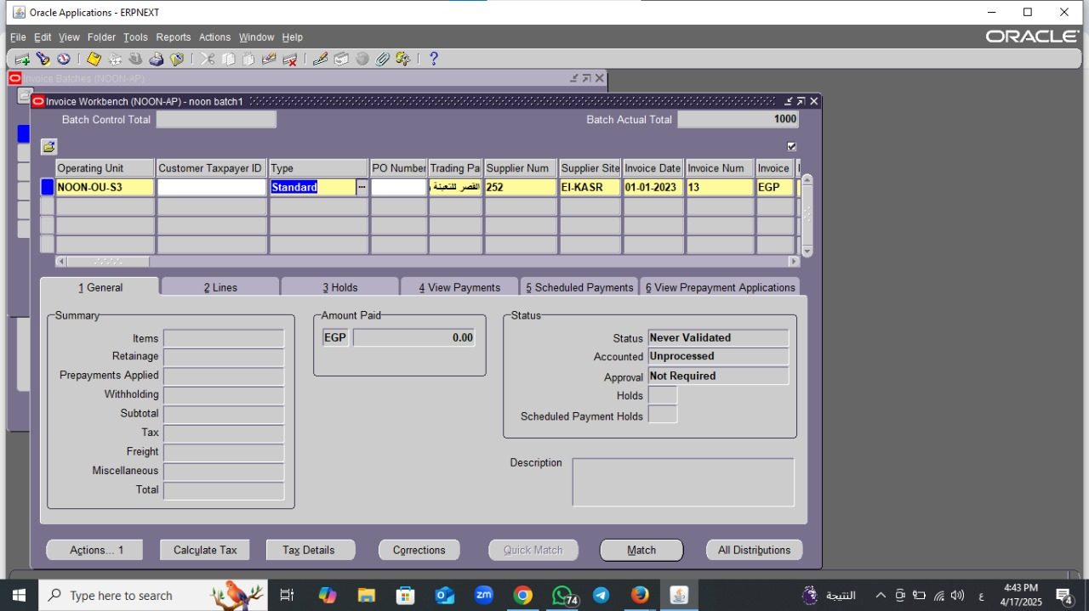

_4 Invoice
Payables >Invoices > Entry > Invoices
OPerating Unit : NooN_OU_S3
Type: Standerd
القصر للتجارة
Supplier Name:
Supplier Namber : 252
Supplier Site : EL_KASR
Status : Never Validated

Slide 41
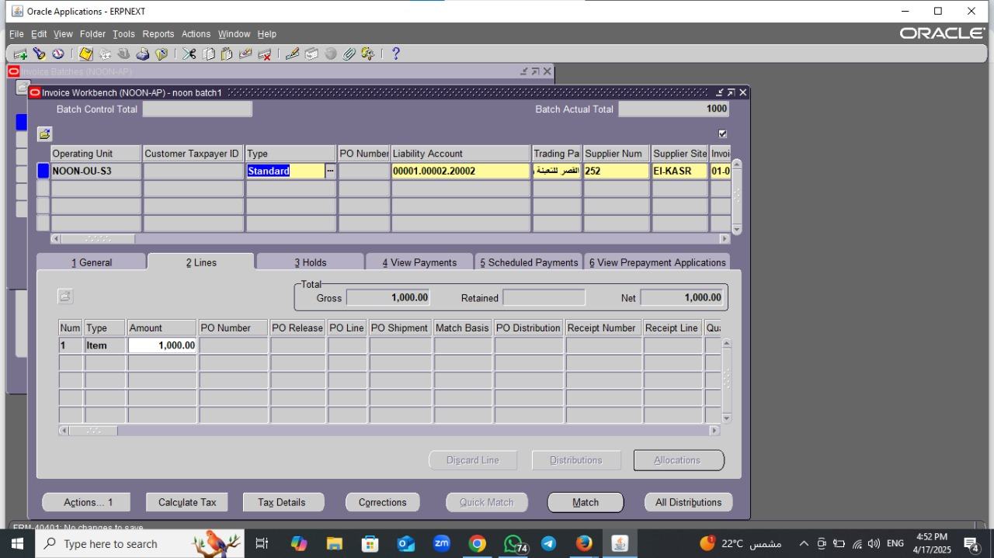
Lines
Amount : 1000
Distributions: Desktop computer (DC)
Defauit Distributions Account:02.001.001.30000

Slide 42
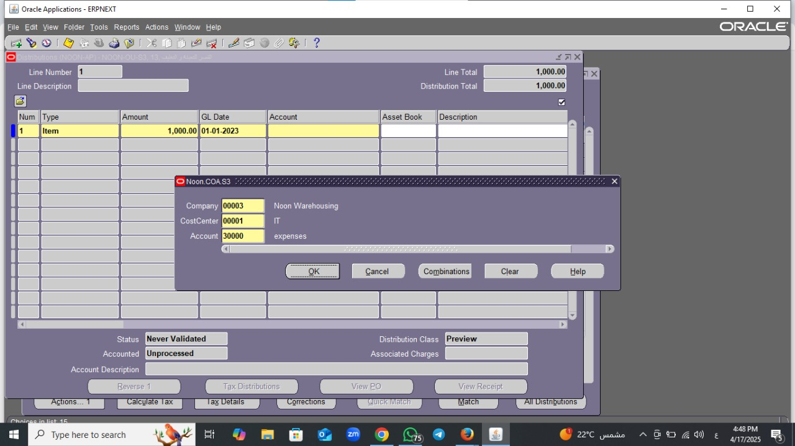
Distributions
Company :00003
Cost center : 00001
Account :30000

Slide 43

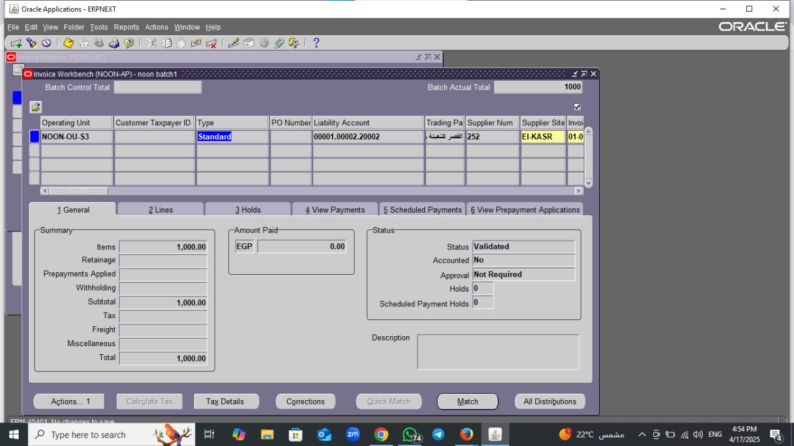
بظهر حساب Li ability Account<save
1General <Actions<vaildet
Actions <Caret Account< Finalpost

Slide 44

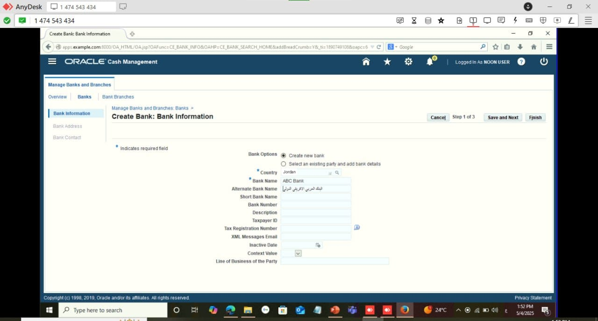
5_Payment
<Bank and Bank Brach
NOON_ AP > Setup > Payment
acreate
Country: Jordan
Bank Name: ABC Bank
Altemate Bank Name : البنك العربي الافريقي الدولي

Slide 45

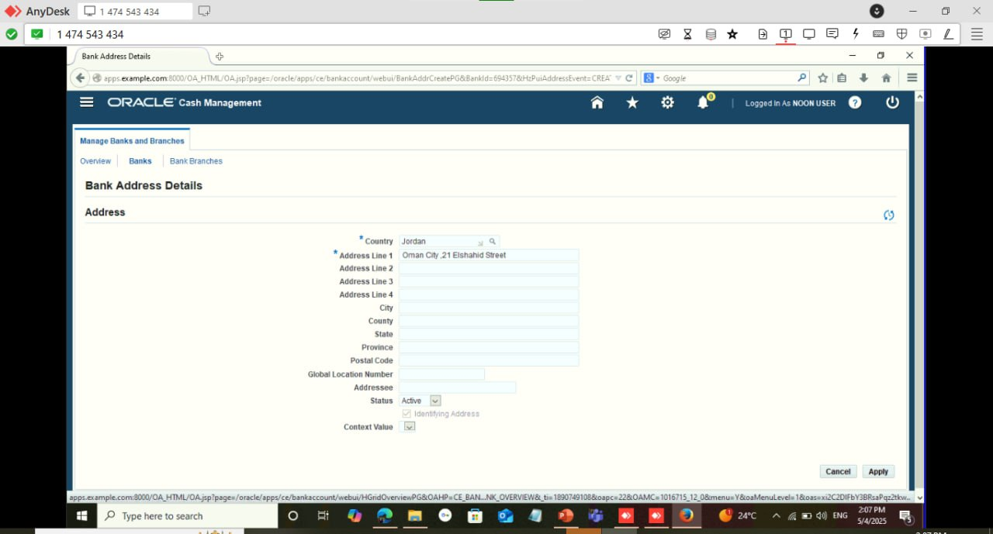
Bank Address
Create
Country:Jordan
Address Line 1: Oman City, 21 Elshahid street
Apply

Slide 46

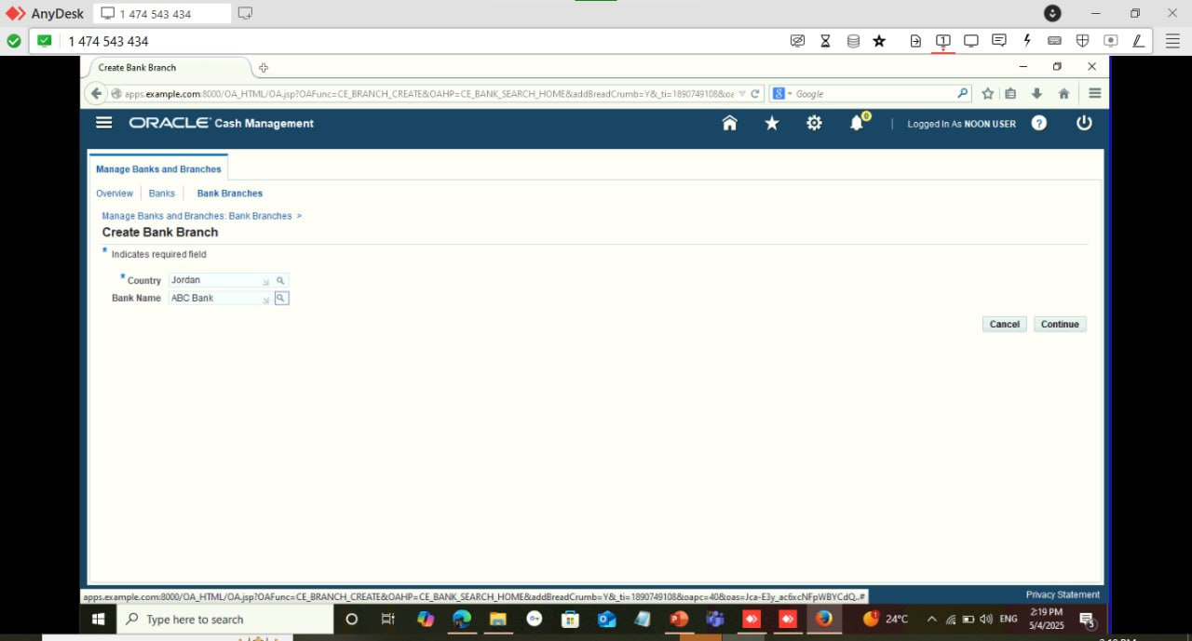
Bank contact
Create contact < cancel< Finish
Bank BranChes< Create
Country:Jordan
Bank Namen: ABC Bank
Continue

Slide 47

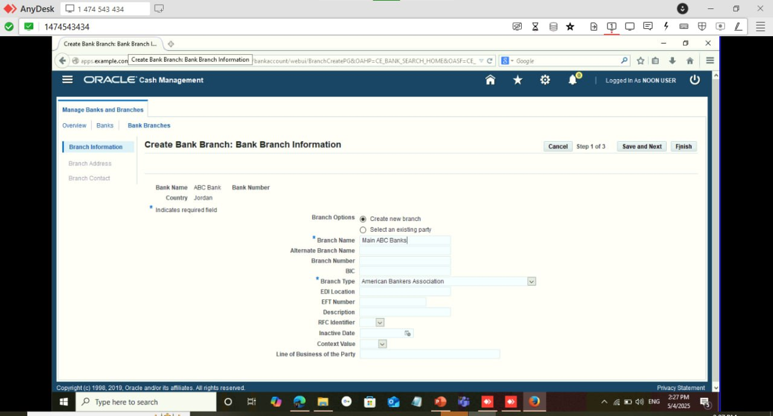
Branch Information
Branch Name: Main ABC Bank
Save and Next

Slide 48


Branch Address
Country:Jordan
Address Line 1: الشلميساني
Apply
Save and Next

Slide 49


Branch Contact < Carete Contact < cancel < Finish

Slide 50


NooN_AP < Setup < Payment < Bank Account

Slide 51


Bank Account
Carete
Country:Jordan
Bank Name: ABC Bank
Branch Name: Main ABC Bank
Continue

Slide 52


Bank Account Owner : NoonE_Commerce
Account Use: Payables Receivables
Negt

